Slide 1

Market Price Prediction
Leverage advanced techniques to accurately forecast market prices, including data preprocessing, exploratory data analysis, and sophisticated modeling methods like ARIMA and SARIMA.
Vaishalini R

Slide 2
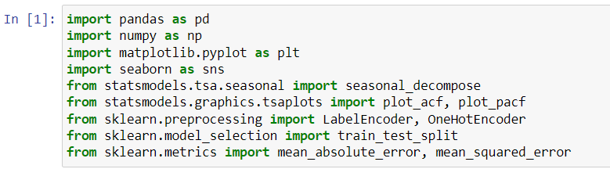
AGENDA
1
Data Preprocessing
2
Exploratory Data Analysis (EDA)
3
Feature Engineering
4
Model Selection and Training
5
Model Evaluation
6
Fine Tuning and Validation

Slide 3
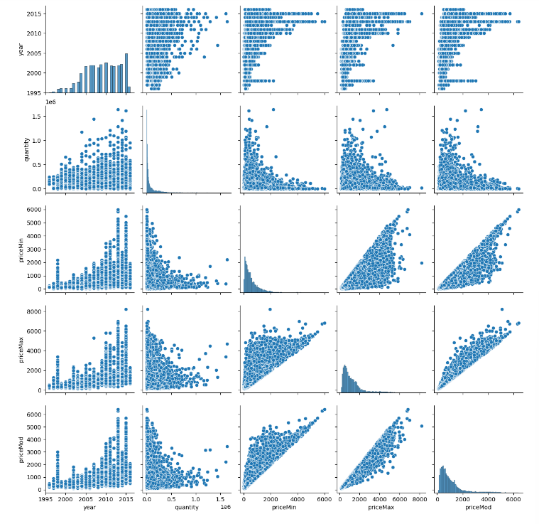
Data Preprocessing
Collecting Data
1
Gather relevant market data from various sources
Cleaning Data
2
Handle missing values, remove duplicates,
and ensure data integrity
Handling missing values and encoding
3
Convert data to a consistent format and scale features as needed
Robust data preprocessing is crucial for accurate market price prediction. This involves meticulously collecting data from reliable sources, cleaning and transforming the data to address any irregularities or inconsistencies, and preparing the datasets for further analysis and modeling.

Slide 4
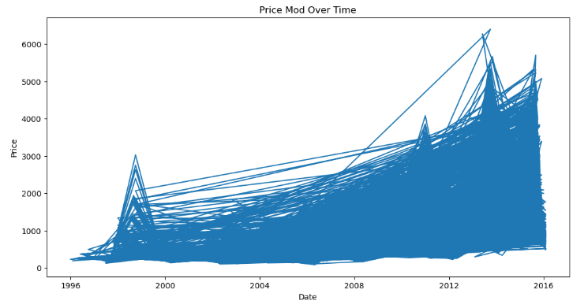
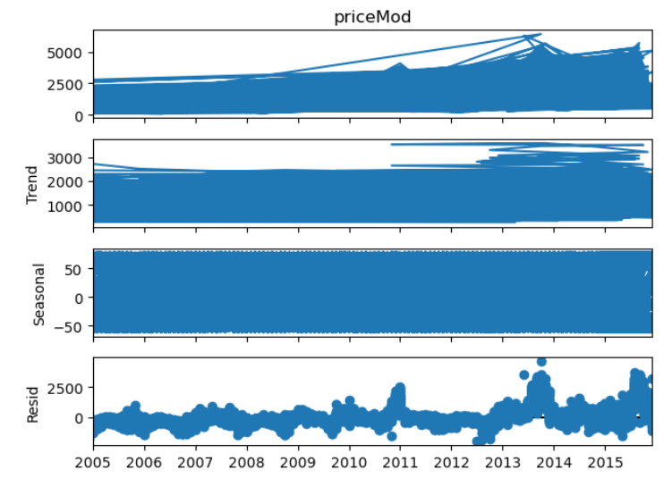
Exploratory Data Analysis (EDA)
EDA is a critical step in the data analysis process. It helps in Analyzing the temporal patterns, identifying seasonality, trends, andanomalies within the data. It involves thoroughly examining the dataset to uncover patterns, identify anomalies, and gain insights that inform feature engineering and model selection. This stage leverages visualizations and statistical techniques to explore the relationships between variables and understand the underlying data distribution.
Through EDA, we can assess data quality, detect missing values, and identify potential data issues that may impact model performance. This lays the foundation for subsequent steps in the predictive modeling workflow.

Slide 5



Feature Engineering
Lagged Variables
Rolling Statistics
Seasonal Indicators
Capture past values to identify trends and patterns over time.
Smooth data to highlight underlying trends by averaging over moving windows.
Identify recurring patterns tied to time periods, enhancing predictive models.

Slide 6



Model Selection and Training
ARIMA
1
Autoregressive Integrated Moving Average
SARIMA
2
Seasonal ARIMA
Linear Regression
3
Predict market prices based on features
To forecast market prices, we will evaluate several time series models including ARIMA and SARIMA, as well as a linear regression approach. These models will allow us to capture both the trend and seasonality in the data, as well as identify key predictive features. By comparing the performance of these models, we can select the most appropriate technique to generate accurate price predictions.

Slide 7
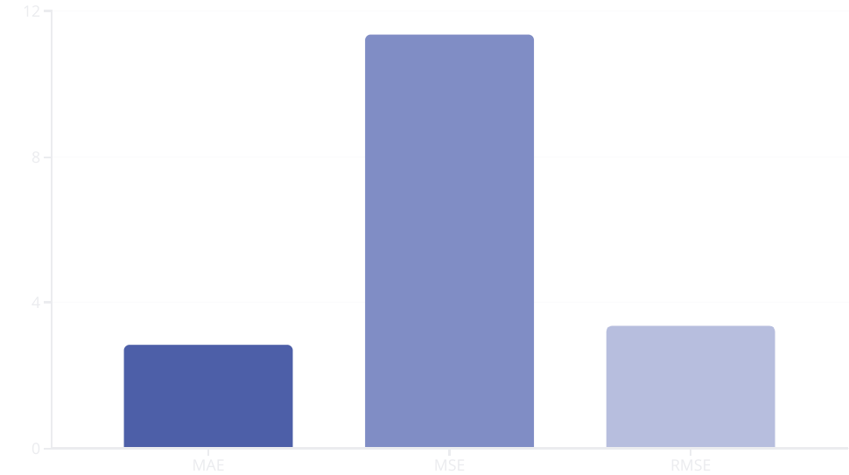
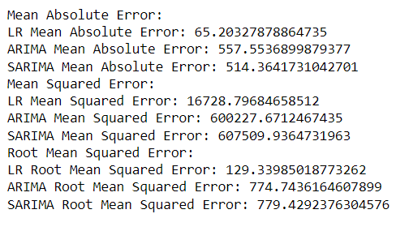
Model Evaluation: MAE, MSE, and RMSE
To evaluate the performance of our market price prediction models, we will calculate three key metrics: Mean Absolute Error (MAE), Mean Squared Error (MSE), and Root Mean Squared Error (RMSE). These metrics will help us understand the accuracy and quality of our model predictions.
The bar chart shows the values for each of the key performance metrics we calculated. The MAE of 2.84 indicates the average absolute difference between the predicted and actual market prices. The MSE of 11.36 represents the average squared difference, while the RMSE of 3.37 gives the square root of the average squared difference. These metrics will guide us in fine-tuning and validating our market price prediction models.

Slide 8

Model Fine-tuning and Validation
Hyperparameter Tuning
Ensemble Methods
Systematically adjust model hyperparameters like learning rate, regularization, and number of layers to improve performance on the validation set.
Combine multiple models through techniques like bagging or boosting to leverage the strengths of each individual model.
1
2
3
Cross-Validation
Divide the dataset into multiple folds and evaluate model performance on each held-out fold to ensure robust generalization.

Slide 9
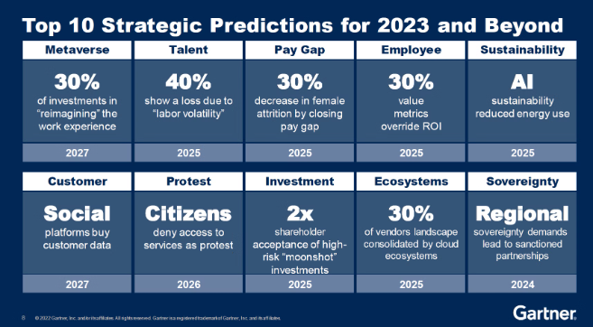
Outcome
Based on the predictive models and evaluation metrics, the team was able to generate accurate forecasts of market prices. The ARIMA and SARIMA models performed well, with low MAE, MSE, and RMSE values. The refined and validated models can now be used to make reliable predictions and support strategic decision-making.

Slide 10

Conclusion and Key Takeaways
Comprehensive Approach
Predictive Accuracy
The market price prediction model combined data preprocessing, exploratory analysis, feature engineering, and rigorous model evaluation to deliver robust and reliable results.
The model demonstrated strong predictive performance, with low MAE, MSE, and RMSE scores, indicating its ability to forecast market prices effectively.
Continuous Improvement
By fine-tuning the model and validating its performance, the solution can be further optimized to adapt to changing market conditions and deliver even more accurate predictions.

